Slide 1
DIGITAL Medical Countermeasures (MCMs)
Empowering people to respond to health security threats through rapidly deployable digital health tools
EZ-BAA Funding Opportunity #17
DigitalHealth@hhs.gov
Notes:
Welcome to the new ASPR PowerPoint template. Each slide contains helpful information for making the entire presentation user-friendly and accessible to people of all abilities. Please play specific attention to the Notes section for each slide for more detailed information on adhering to ASPR PowerPoint design requirements.
To begin development of your presentation, simply begin typing directly on each slide within this template. Right click on each slide and choose Duplicate Slide to use the same slide template for another slide. Choose Delete Slide if the slide template is not needed.
This presentation is formatted to include the classification of “Unclassified.” To change the classification to “Unclassified//For Official Use Only, “Confidential,” or “Secret” select the View tab above then Slide Master. You must change the classification on each template slide. Once all slides are updated with the new classification, click on Close Master View.
Note that the title slide should display the overall classification of the entire briefing. For example, if the brief consisted of three Unclassified slides, one Unclassified//For Official Use Only, and one Confidential slide, the overall classification of the entire briefing would be Confidential, since that is the highest level of classification in the brief. The classification “Confidential” would be listed on the title slide.
Definitions of classifications:
Unclassified: This slide set can be distributed widely to all target audiences, including the general public. This slide set can also be posted to the meeting sponsor’s website.
Unclassified/For Official Use Only: This slide set is for limited distribution only. Although the information presented is unclassified, it may not be appropriate for public release. Often these slides contain information from documents or results from studies that are in draft form and have not been cleared for public use.
Confidential: This slide set includes information of which reasonably could be expected to cause damage to the national security.
Secret: This slide set includes information of which reasonably could be expected to cause serious damage to the national security. Secret classification is reserved for such things as government programs safeguarding nuclear materials; developing, production, or use of weapons of mass destruction; foreign relations/activities of the US., including confidential sources, etc. We do not expect many, if any, ASPR presentations to be classified at the Secret level.

Slide 2







Digital MCMs Purpose
Traditional MCMs
To develop innovative digital health tools to augment traditional medical countermeasures against infectious diseases and other health security threats
Vaccines
Diagnostics
Therapeutics
Digital tools can bridge gaps and can augment traditional MCMs:
Provide personal health situational awareness
Facilitate the right responses
Inform at national and local levels
Digital MCMs
Devices
AI & ML
Data Analytics

Slide 3
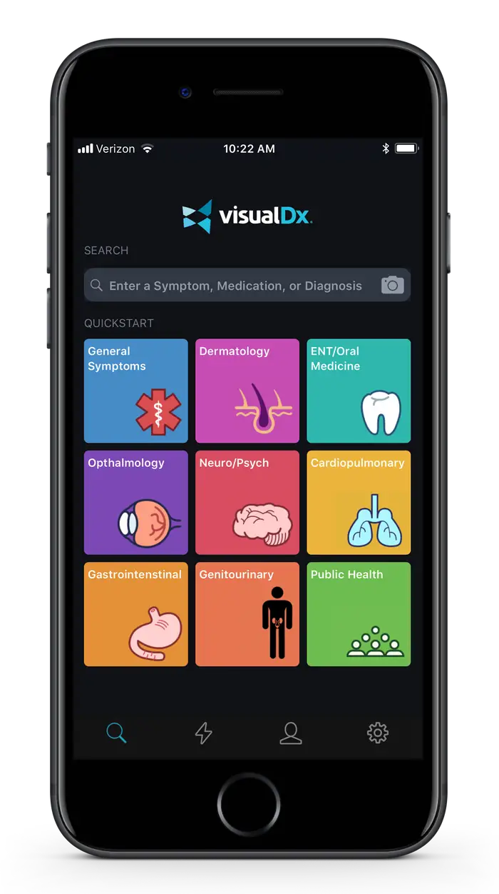








Why are digital MCMs important?
Smartphone Apps with AI/ML
Rapid
No additional device required
Use at home
Universally available & equitable
Smartphones are ubiquitous
Scalable
Sustainable
Inexpensive
Easy to use

Slide 4





Digital MCM Partners
Developing a machine learning algorithm for the identification of MPOX based on images of skin lesion morphology and questionnaire responses
Telehealth service with AI/ML to provide a comprehensive program of diagnosis, assessment, triage, reporting and tracking of SARS-CoV-2 infections
Development of AudibleHealth Dx AI/ML platform using forced cough vocalization (FCV) to diagnose
respiratory infections
?
Developing and validating an AI-enabled solution for COVID-19 screening using seconds of cough and/or speech audio
Analysis of COVID-19 testing data to identify persons who have received a COVID vaccination through self-reporting and who subsequently had a COVID-19 positive test
The funding opportunity is open and your company can be the next!

Slide 5
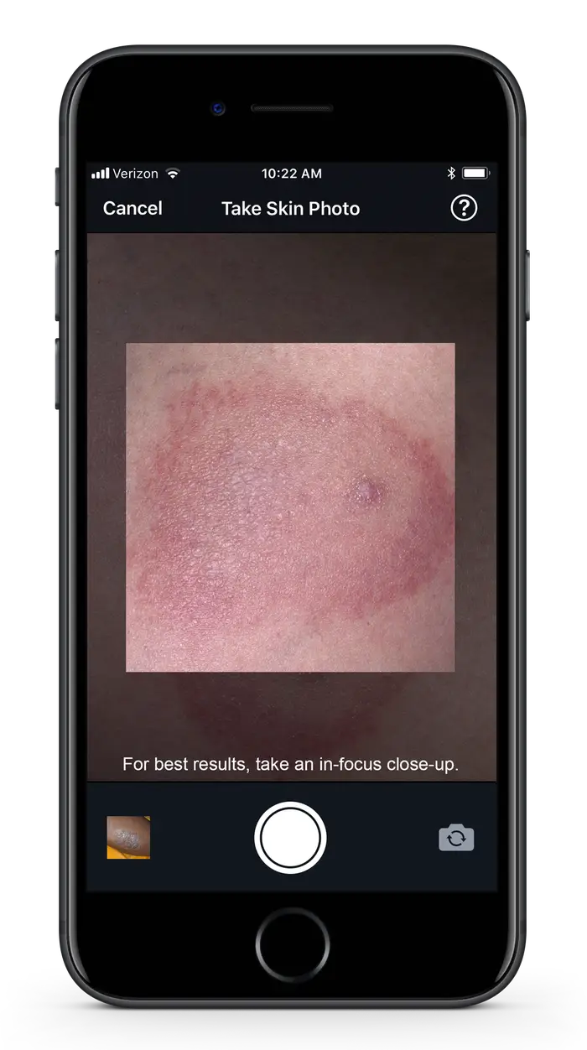
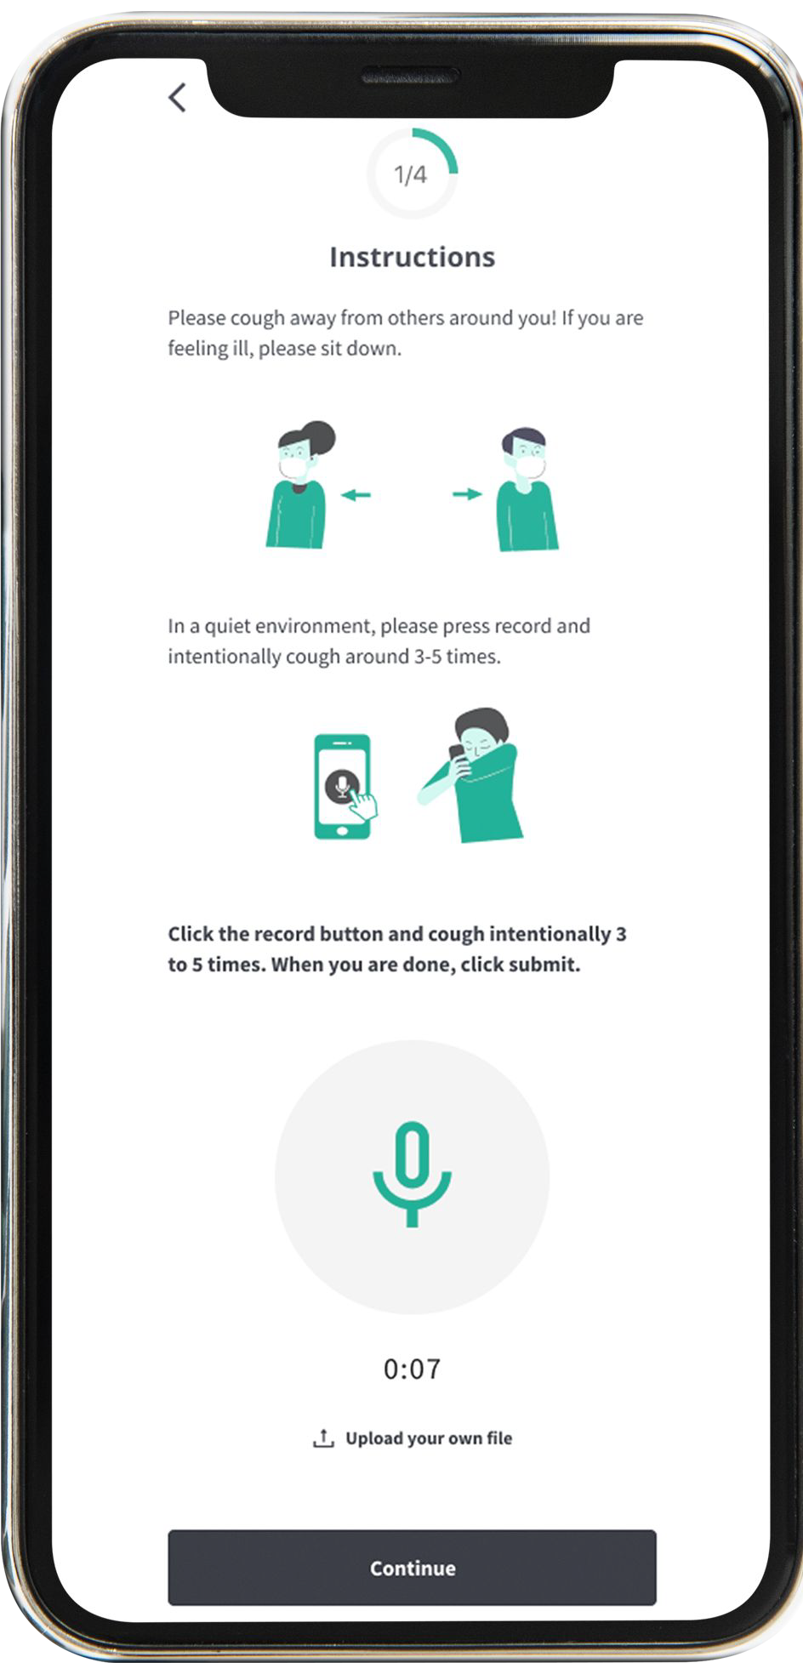



Digital MCM Portfolio: Diagnostics
Audio-based
Image-based
Smartphone Apps with AI/ML as diagnostic tools

Slide 6



Digital MCM Program Goals
Establish a Suite of Digital Diagnostic Tools
To provide an accelerated response to infectious disease and other health security threats
Demonstrate Utility of Non Traditional Data Sources
To enhance our understanding of health security threats and the efficacy of medical countermeasures
Evaluate Novel Data Analytics Approaches
To offer new solutions that augment traditional medical countermeasures
DRIVe would like to partner with the industry to advance the development of digital medical countermeasures including diagnostics, prophylactic and therapeutic interventions to prepare for future pandemics and health security threats

Slide 7

















We are looking to diversify digital applications
Digital Tools
Illness detection
Disease surveillance
MCM uptake, effectiveness, outcomes
Clinical Intervention Support
Mobile Apps
Wearables
Medical Counter-measures
Risk assessment
Diagnostics/Screening
Artificial Intelligence
Machine Learning
Clinical trial support
Predictive analytics
Prophylactics/Adjuvants
GPT-X
Health Data
Public Data
Treatment/Therapeutics
Public health guidance dissemination

Slide 8


Responsiveness
Data and analytics-based
Mobile apps and physiological monitoring using wearables
Must be innovative, effective, equitable, affordable, easy-to-use, broadly and rapidly available
Desired use case: infectious diseases or CBRN health security threats
Existing health data may be used under appropriate privacy safeguards
Existing commercially available digital tools
Tools requiring frequent regulatory approvals
Use of hardware not broadly accessible
Clinical utility of existing technologies for infection severity/sepsis

Slide 9

DRIVe’s EZ-BAA funding vehicle
EZ-BAA Highlights
Fast, easy to use, and flexible
Can award contracts within 30-60 days of submission
$749,999 max government funding
30-50% resource contribution requirement
BARDA DRIVe Abstract Review Process Flow Chart
Market Research Call with DRIVe AOI PM
Abstract to Award
Abstract Submission
Award
Successful Negotiation
Acceptable
Initial Abstract Review
Proposal Evaluation
Interested
Submission of SOW
Cost & Technical Information
Not Interested
Not Accepted
Respondent Notified
Respondent Notified

Slide 10


Contact us to learn more
DRIVe Area of Interest #17: Digital Medical Countermeasures
digitalhealth@hhs.gov
DRIVe website: https://drive.hhs.gov

